Slide 1
Tema seminar
Butacu Stefan-Alexandru

Slide 2

eNUNT
9.2.19.2 Utilizand rezolutia liniara, demonstrati semidistributivitatea cuatificatorului $"∃“$ fata de “$∧$”: $⊢$ ($∃$x)(P(x) $∧$Q(x)) $→$ ($∃$x)(P(x) $∧$ ($∃$x)Q(x). Arătaţi că implicaţia inversă nu are loc.

Slide 3

Obtinerea multimii de clauze
ITD
$⊢$ ($∃$x)(P(x) $∧$Q(x)) $→$ ($∃$x)(P(x) $∧$ ($∃$x)Q(x) = U =>
($∃$x)(P(x) $∧$Q(x)) $⊢$ ($∃$x)(P(x) $∧$ ($∃$x)Q(x)
$U_{1}$ $≡$($∃$x)(P(x)$∧$Q(x))
V $≡$ ($∃$x)(P(x) $∧$ ($∃$x)Q(x)

Slide 4


Obtinerea Formei normale cauzale
$U_{1}$ $≡$($∃$x)(P(x)$∧$Q(x))
$≡$ P(a)$∧$Q(a) = $C_{1}∧C_{2}$
Eliminarea cuatificatorului $∃$
$$x←a$$

Slide 5
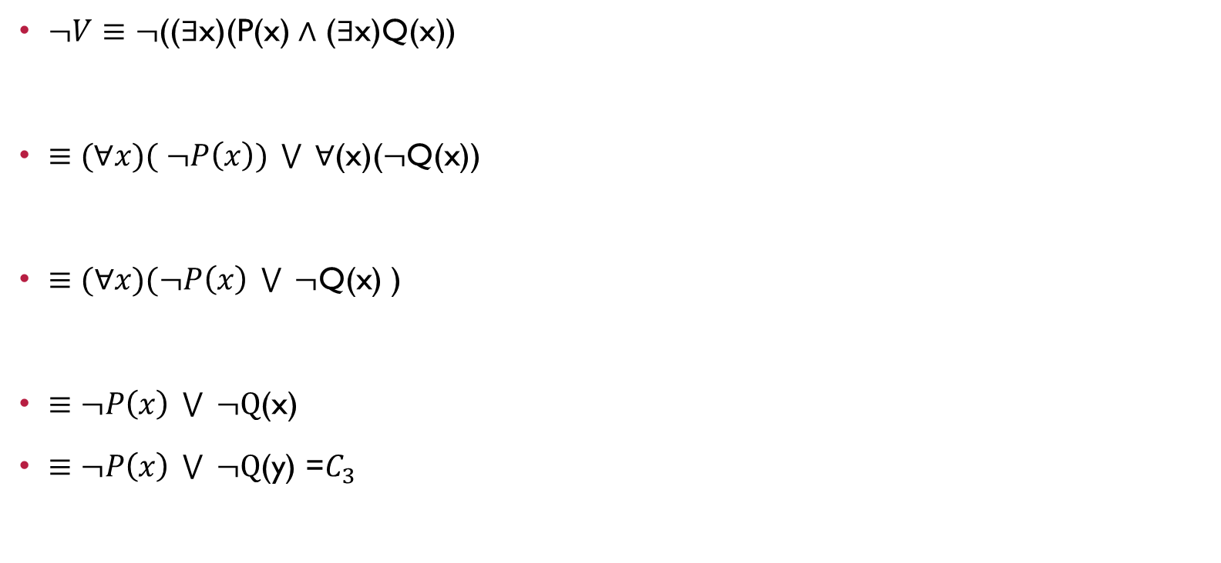
Obtinerea Formei normale cauzale
$¬V≡¬$(($∃$x)(P(x) $∧$ ($∃$x)Q(x))
$≡$ $(∀x)( ¬P\left(x\right)) \bigvee{ }∀\text{(}\text{x}\text{)(}¬\text{Q}\text{(}\text{x}\text{))}$
$≡(∀x)(¬P\left(x\right) \bigvee{ }¬\text{Q}\text{(}\text{x}\text{) ) }$
$≡¬P\left(x\right) \bigvee{ }¬\text{Q}\text{(}\text{x}\text{) }$
$≡¬P\left(x\right) \bigvee{ }¬\text{Q}\text{(}\text{y}\text{) =}C_{3}$
De Morgan
Se utilizeaza ecihvalente logice care reprezinta legile de extragere a cuatificatorilor in fata formulei
Eliminarea cuatificatorului $∀$
Redenumirea variabilelor

Slide 6

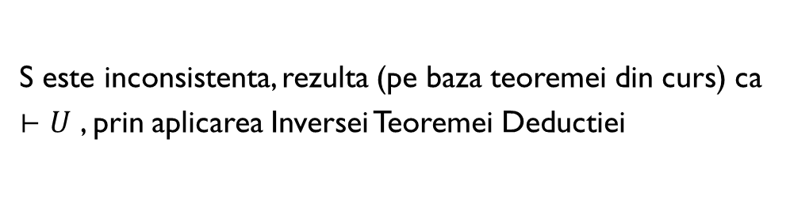
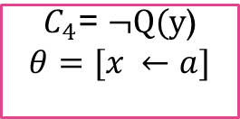
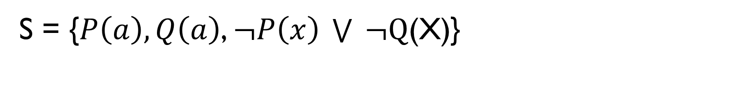


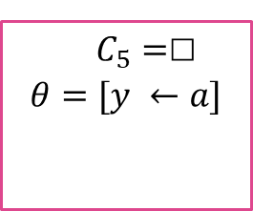

S = {$P\left(a\right), Q\left(a\right)$, $¬P\left(x\right) \bigvee{ }¬\text{Q}\text{(}\text{x}\text{)}$}
$$C_{1}= P\left(a\right)$$
$$C_{2}=Q\left(a\right)$$
$$C_{3}=¬P\left(x\right) \bigvee{ }¬\text{Q}\text{(}\text{y}\text{)}$$
$$C_{4}\text{= }¬\text{Q}\text{(}\text{y}\text{)}$$
$$θ=[x ←a]$$
$$C_{2}=Q\left(a\right)$$
$C_{5}=$□
$$θ=[y ←a]$$
S este inconsistenta, rezulta (pe baza teoremei din curs) ca $⊢U$ , prin aplicarea Inversei Teoremei Deductiei
TCC

Slide 7

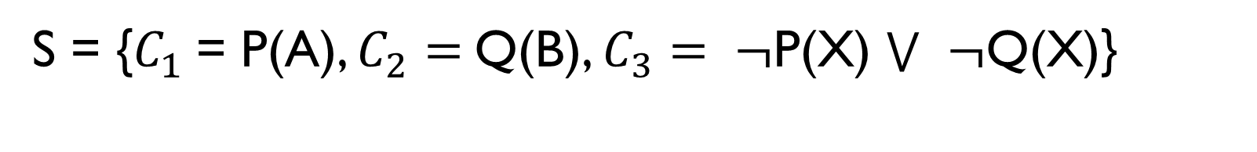
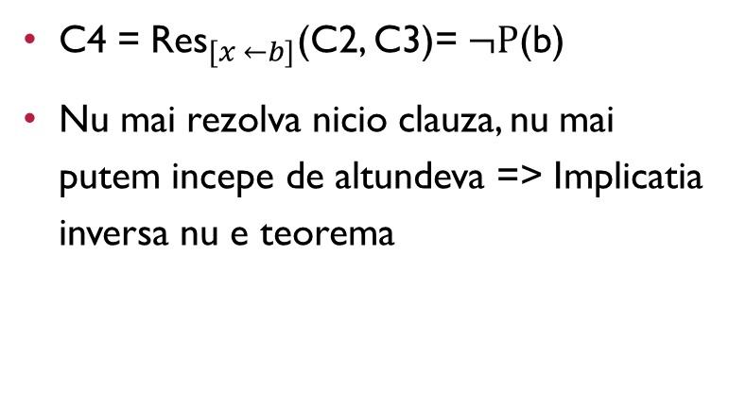
S = {$C_{1}$= P(a), $C_{2}=$Q(b), $C_{3}= ¬$P(x) $¬$Q(x)}
Incercarea 1
Incercarea 2
C4 = ${\text{Res}}_{[x ←a]}$(C1, C3)= $¬$Q(a)
Nu mai rezolva nicio clauza, incercam sa incepem din alta parte
C4 = ${\text{Res}}_{[x ←b]}$(C2, C3)= $¬P$(b)
Nu mai rezolva nicio clauza, nu mai putem incepe de altundeva => Implicatia inversa nu e teorema

